Slide 1
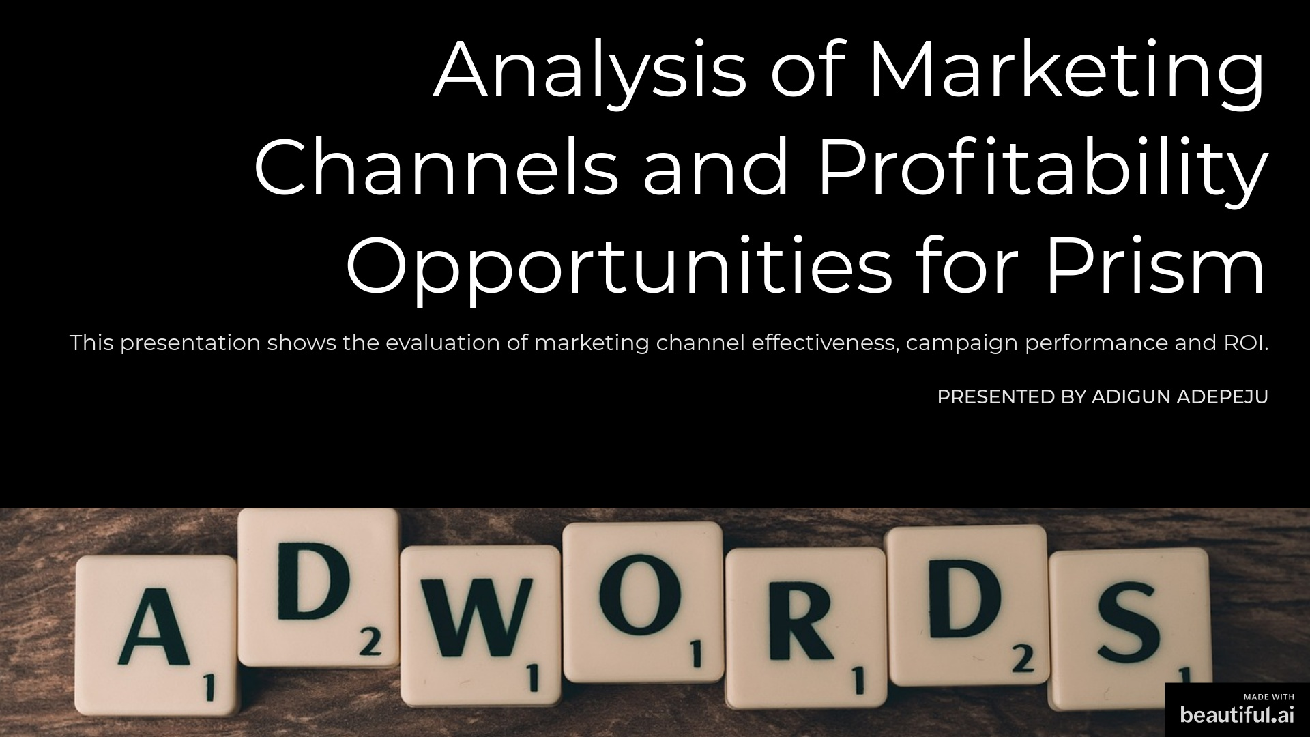

Slide 2
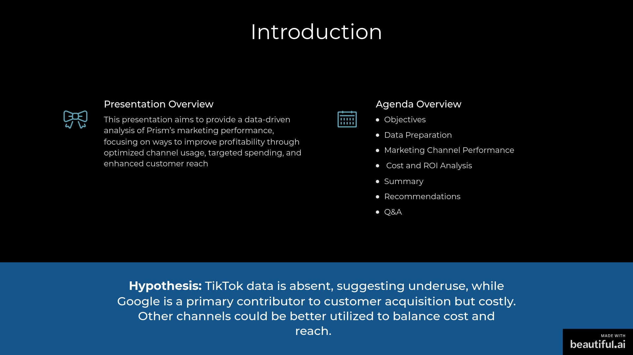

Slide 3
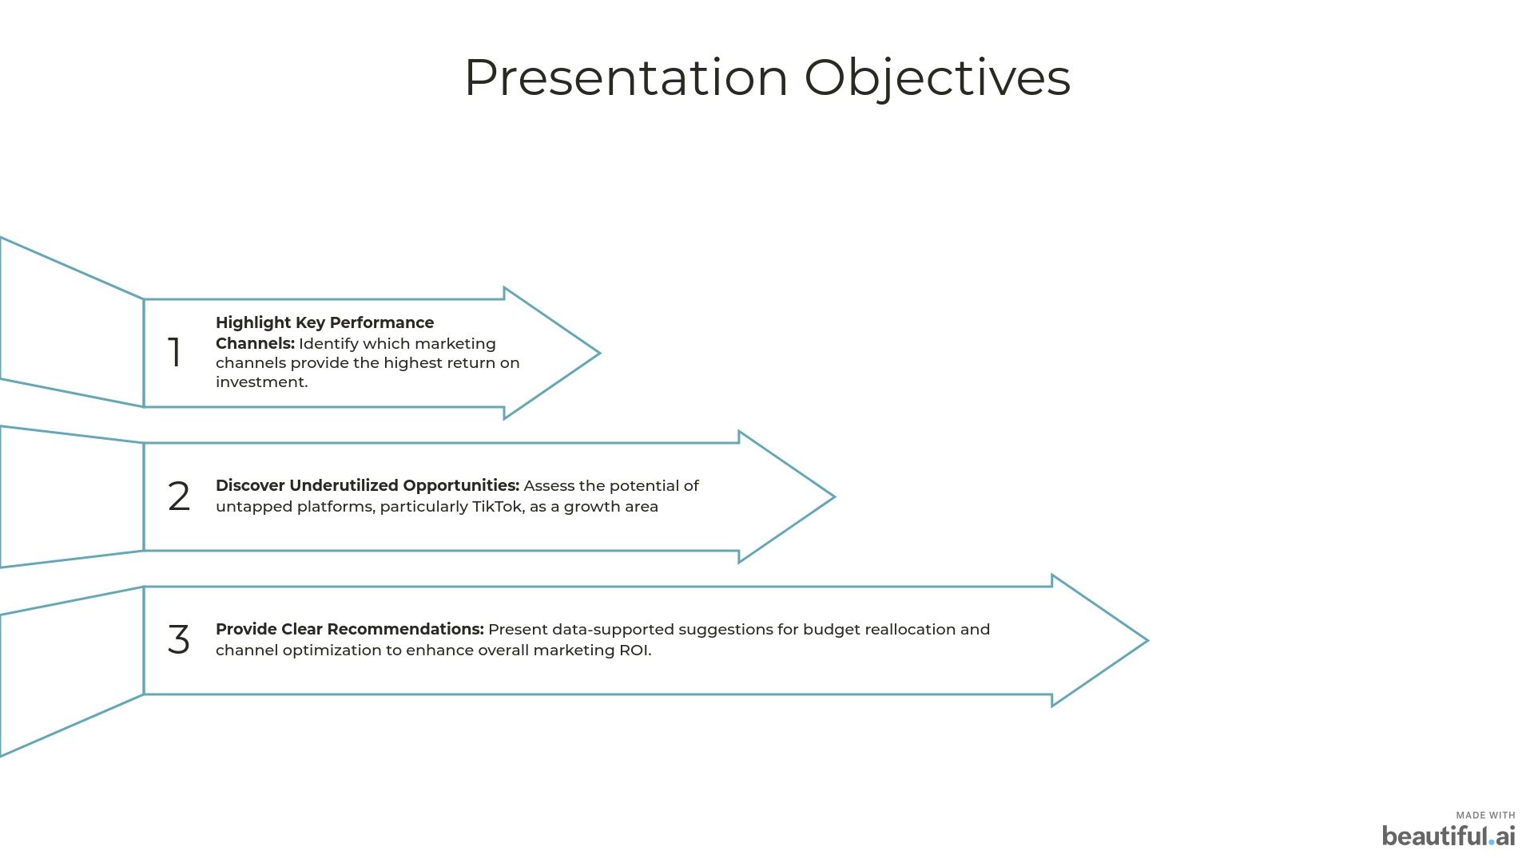
Notes:
This slide outlines the key objectives we aim to achieve during this presentation. First, we will delve into the performance of various marketing channels, pinpointing those that yield the highest return on investment. Understanding where our resources are best allocated is crucial for maximizing impact. Next, we will explore underutilized opportunities, particularly focusing on platforms like TikTok, which present significant growth potential. Finally, we will offer clear, data-driven recommendations for budget reallocation and channel optimization. These insights will empower us to enhance our overall marketing ROI effectively.

Slide 4
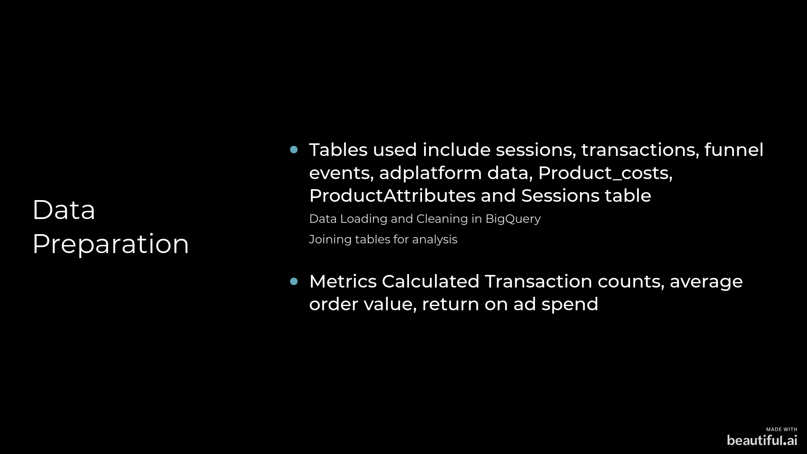

Slide 5
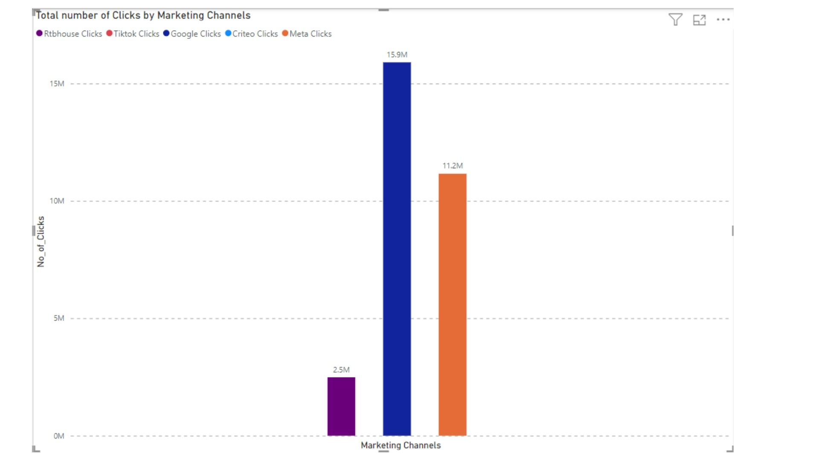
Notes:
This bar chart provides a clear visual representation of the total number of clicks generated by various marketing channels. Notably, Google leads with an impressive 15.9 million clicks, indicating its effectiveness in driving traffic. Meta follows with 11.2 million clicks, showcasing its strong presence in the digital marketing landscape. In contrast, RtBhouse has significantly fewer clicks at 2.5 million, suggesting it may need to enhance its strategies to compete effectively. It's also worth noting that TikTok is not represented in this data, which could imply either a lack of data collection or a lesser focus on that platform. Understanding these metrics is crucial for optimizing our marketing efforts and reallocating resources to the most effective channels.

Slide 6
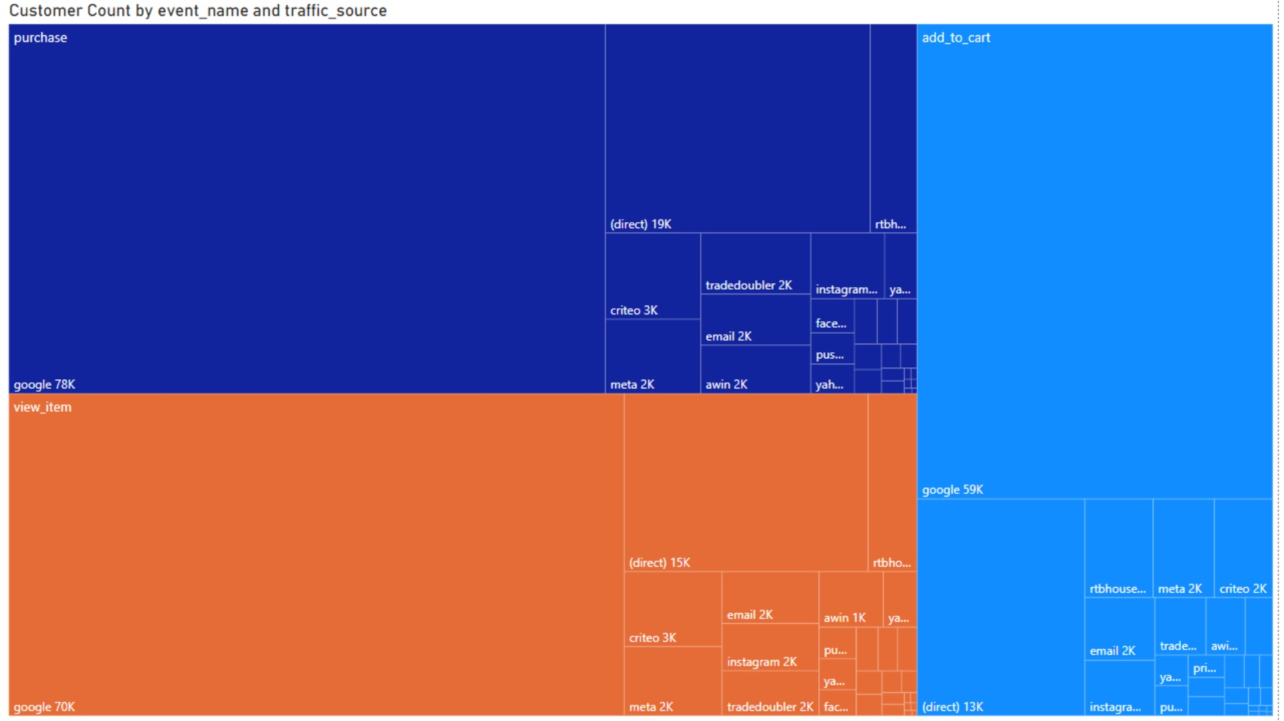
Notes:
This heatmap chart provides a visual representation of customer engagement across various events and traffic sources. The color coding helps us quickly identify the volume of customers associated with each event. For instance, the dark blue section indicates a significant number of customers, totaling 19K, while the orange section represents 70K customers, and the light blue shows 50K. Notably, events like 'purchase' and 'add_to_cart' are crucial for understanding customer behavior. Additionally, the traffic sources reveal that Google is a major contributor, with impressive counts of 78K and 70K customers, while Awin shows a much smaller figure of 2K. This data is essential for strategizing marketing efforts and optimizing customer acquisition channels.

Slide 7
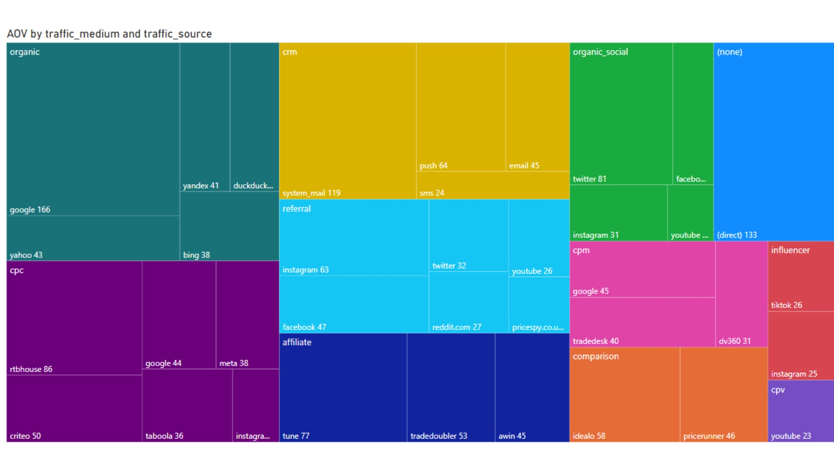
Notes:
This heatmap chart provides a visual representation of the average order value (AOV) segmented by different traffic sources and mediums. The color coding allows us to quickly identify which sources are driving higher AOV. Notably, organic search and direct traffic stand out as significant contributors, indicating that these channels are particularly effective for generating revenue. Additionally, social media platforms like Twitter and Instagram also show promising AOV figures, suggesting that targeted campaigns on these platforms could yield substantial returns. Understanding these dynamics is crucial for optimizing our marketing strategies and allocating resources effectively. By focusing on the most lucrative traffic sources, we can enhance our overall performance and drive growth.

Slide 8
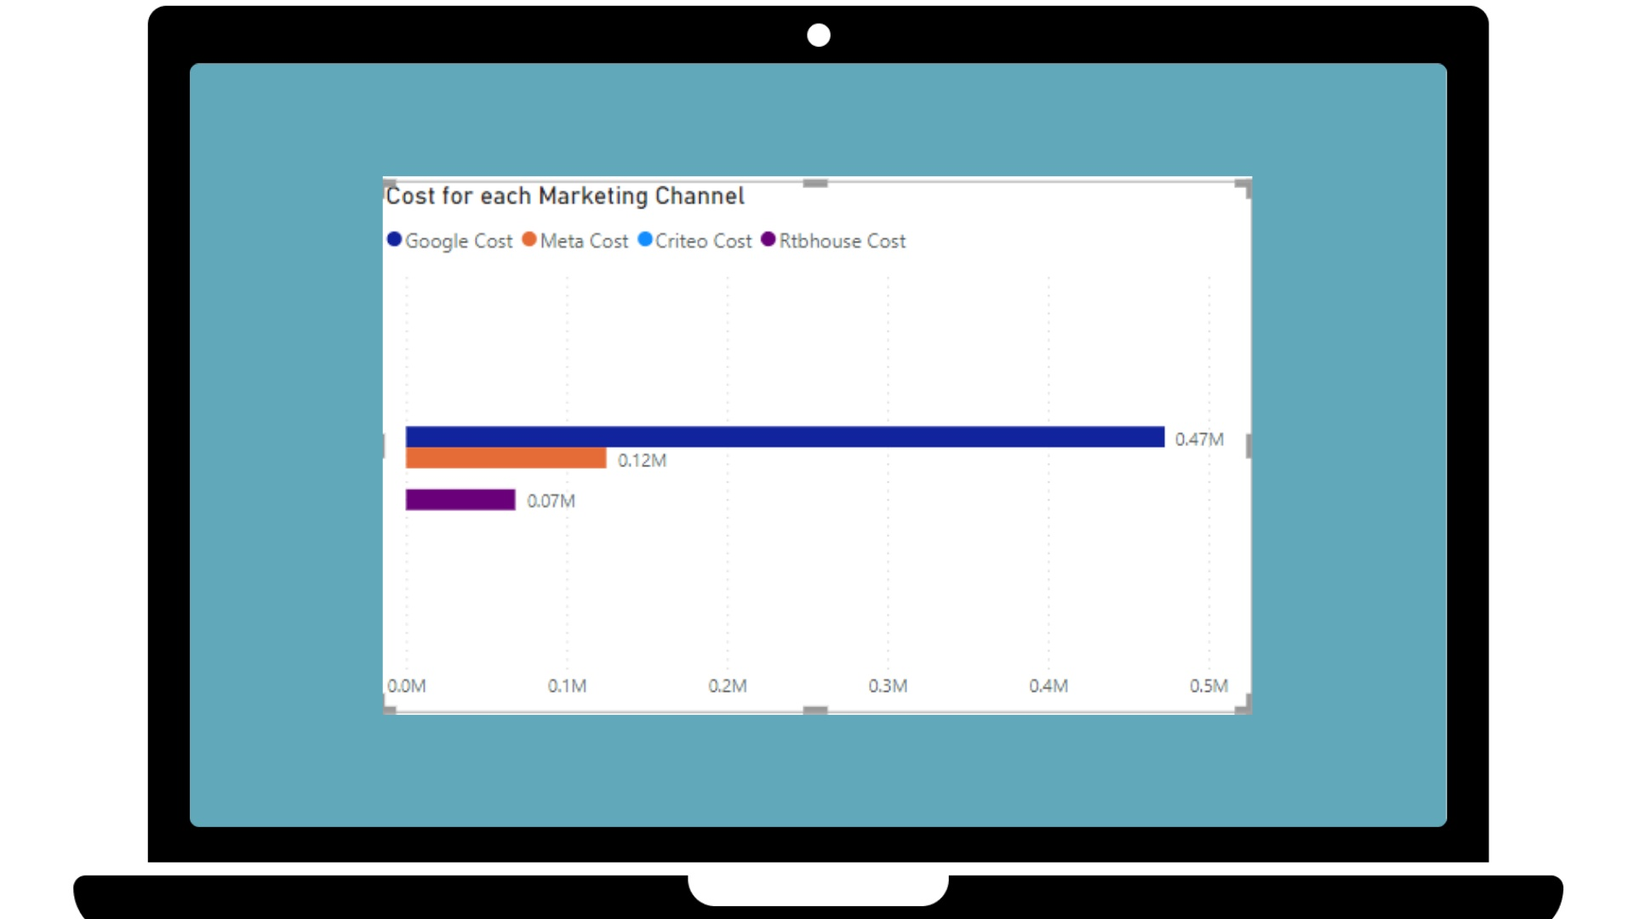
Notes:
This bar chart provides a clear comparison of the costs associated with various marketing channels. Notably, Google stands out with the highest expenditure at 0.47 million, which suggests a significant investment in this platform. In contrast, Meta follows with a cost of 0.12 million, while Criteo and Rtbhouse show much lower costs at 0.07 million and 0.0 million, respectively. This disparity highlights the varying levels of investment across channels and may indicate where we should focus our marketing efforts. Understanding these costs is crucial for optimizing our budget allocation and maximizing return on investment. As we analyze these figures, consider how each channel aligns with our overall marketing strategy and objectives.

Slide 9
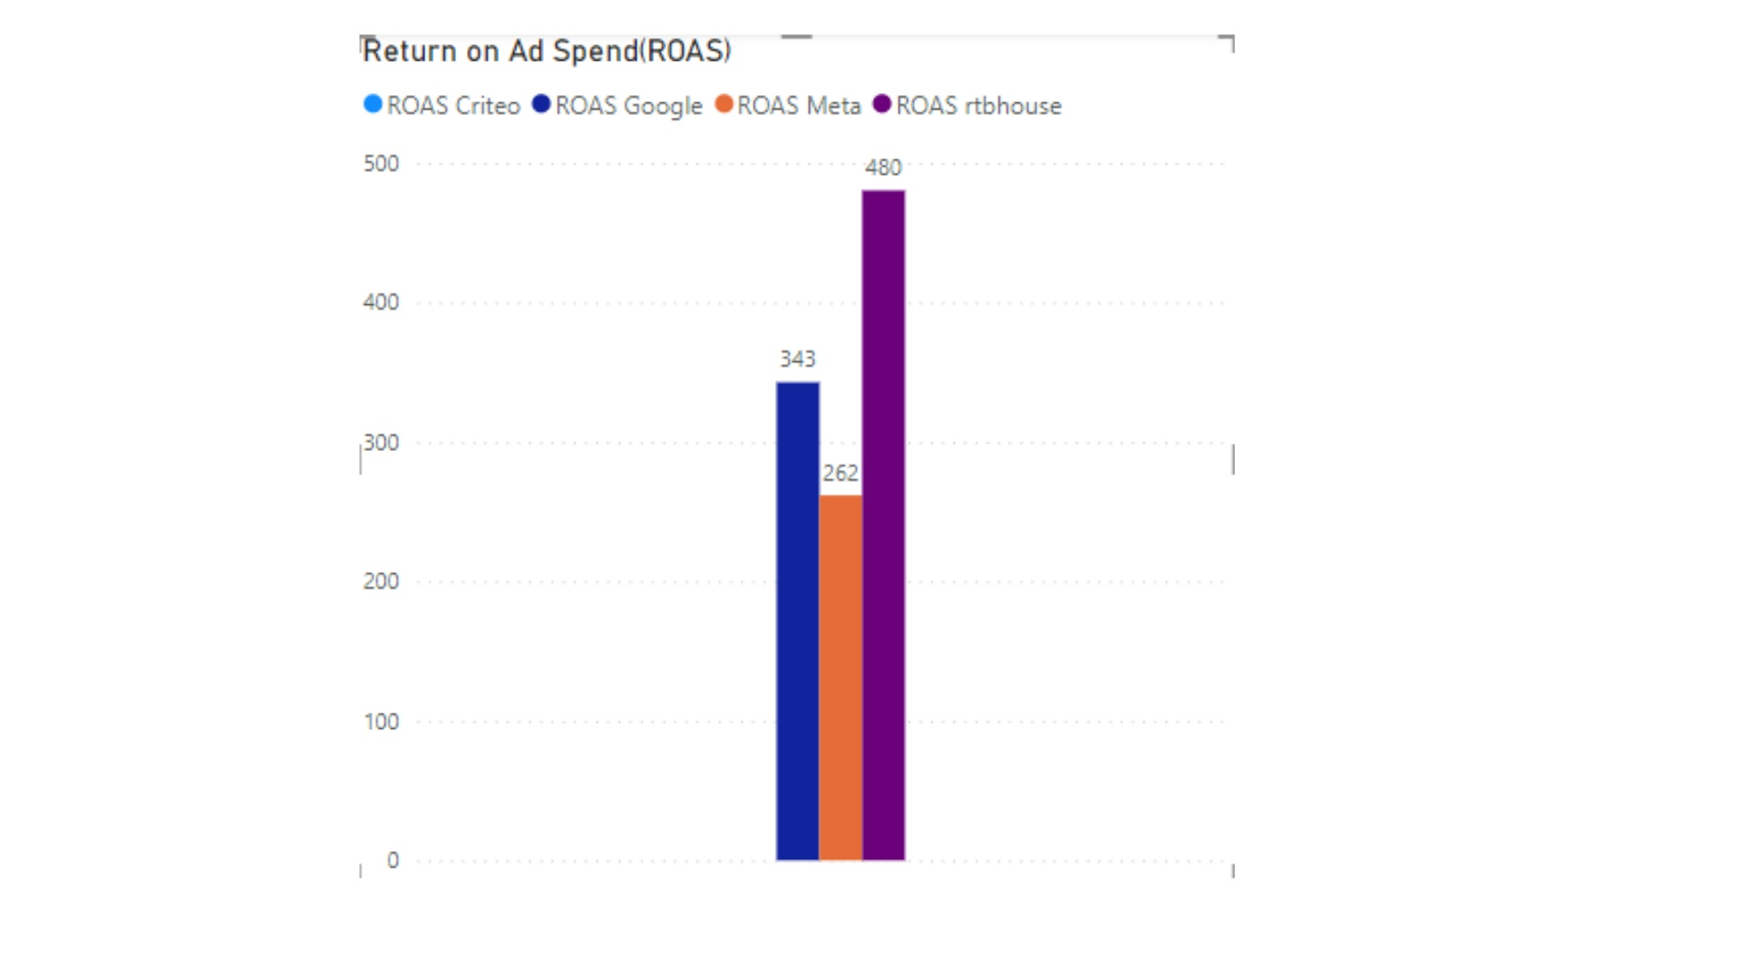
Notes:
This bar chart illustrates the Return on Ad Spend (ROAS) for four key players in the digital advertising space: Criteo, Google, Meta, and rtbhouse. Notably, rtbhouse leads with a remarkable ROAS of 480, indicating a strong return on investment for their advertising efforts. Criteo follows with a solid performance at 343, while both Google and Meta share the same ROAS of 262. The distinct colors for each entity make it easy to compare their performance at a glance. This data not only highlights the effectiveness of these platforms but also provides insights into where advertisers might find the best value for their spending. As we analyze these figures, consider how they reflect broader trends in digital marketing and the competitive landscape.

Slide 10
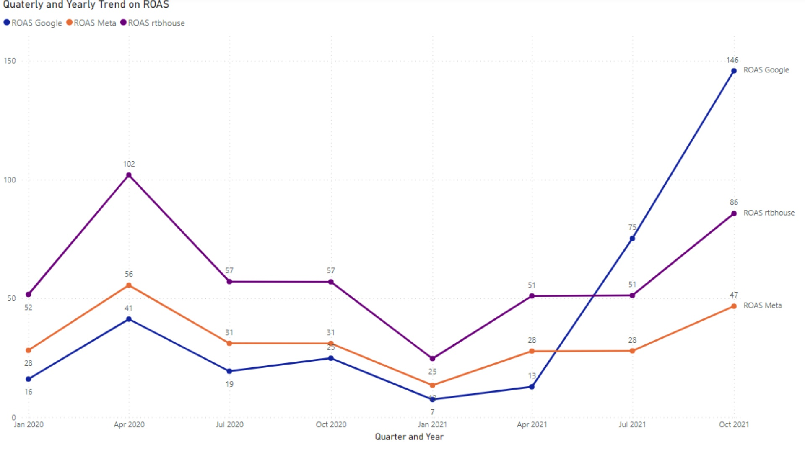
Notes:
This line chart illustrates the quarterly and yearly trends in Return on Advertising Spend (ROAS) for three platforms: Google, Meta, and rtbhouse, spanning from January 2020 to October 2021. Notably, rtbhouse consistently outperforms the others, with peaks in April 2020 and October 2021, indicating effective advertising strategies during these periods. In contrast, Google shows a marked increase in October 2021, suggesting a potential shift in campaign effectiveness or market conditions. Meanwhile, Meta's performance remains relatively stable, with minor fluctuations, which could imply a more consistent but less aggressive advertising approach. Understanding these trends is crucial for optimizing future advertising investments and strategies across these platforms.

Slide 11
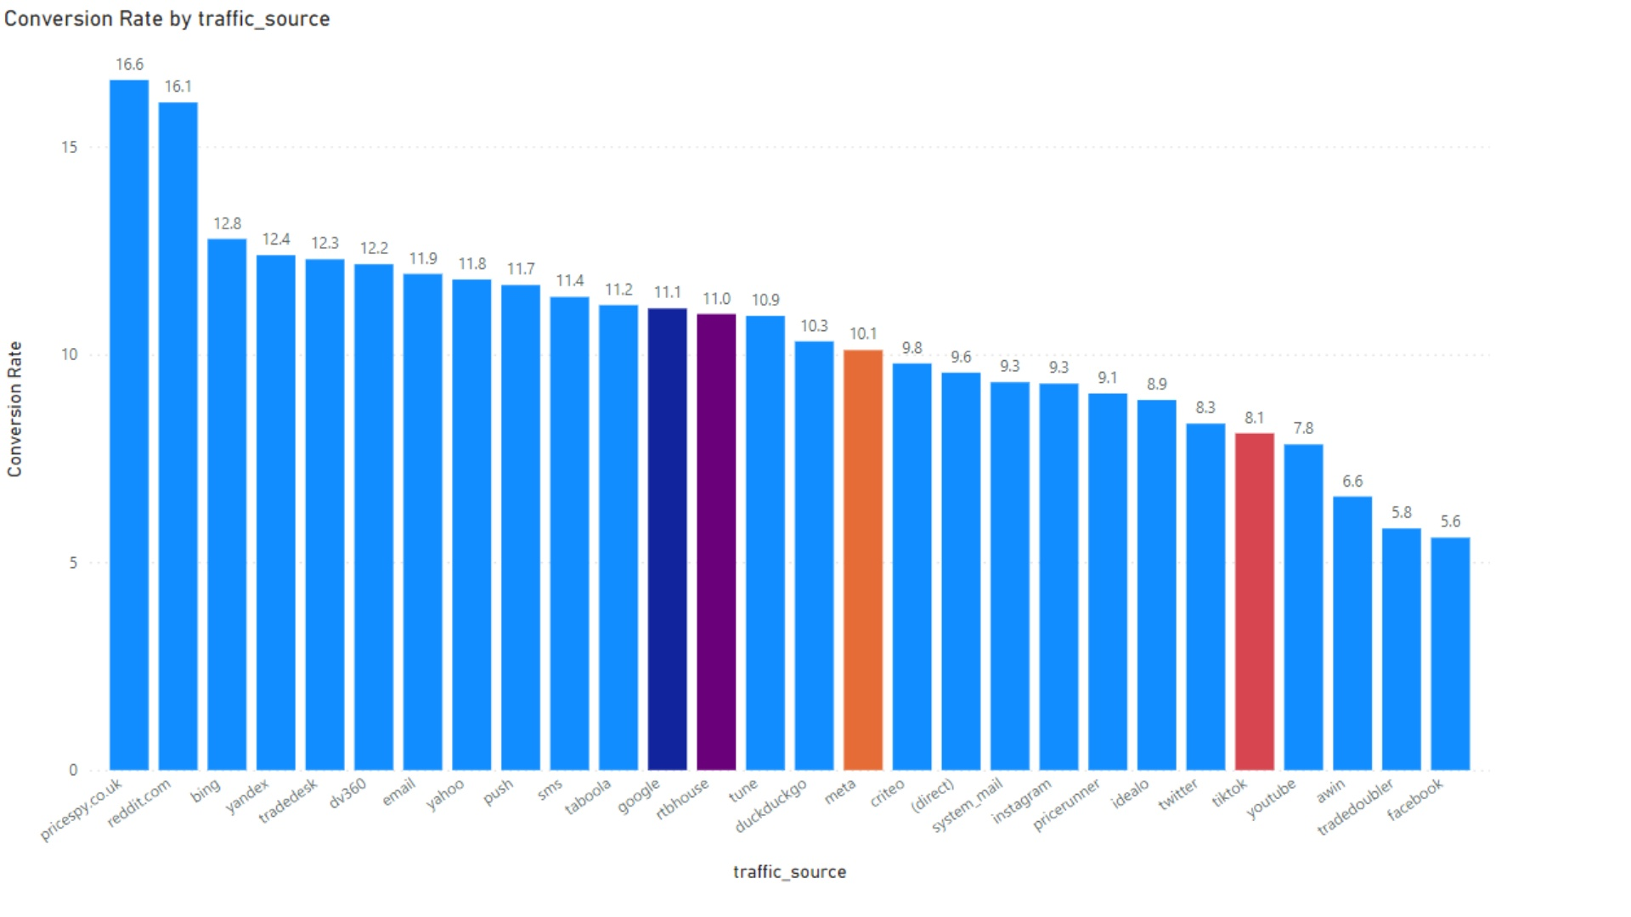
Notes:
This bar chart provides a clear comparison of conversion rates across different traffic sources. Notably, pricespy.co.uk leads with an impressive conversion rate of 16.6%, closely followed by reddit.com at 16.1%. These figures suggest that these platforms are particularly effective in driving conversions, which could inform our marketing strategies. In contrast, facebook and tradebutdoubeller show significantly lower rates at 5.6% and 5.8%, respectively. This disparity highlights the importance of analyzing traffic sources to optimize our efforts. The color coding in the chart helps to quickly identify which sources are performing well and which are not, allowing us to make data-driven decisions moving forward.

Slide 12
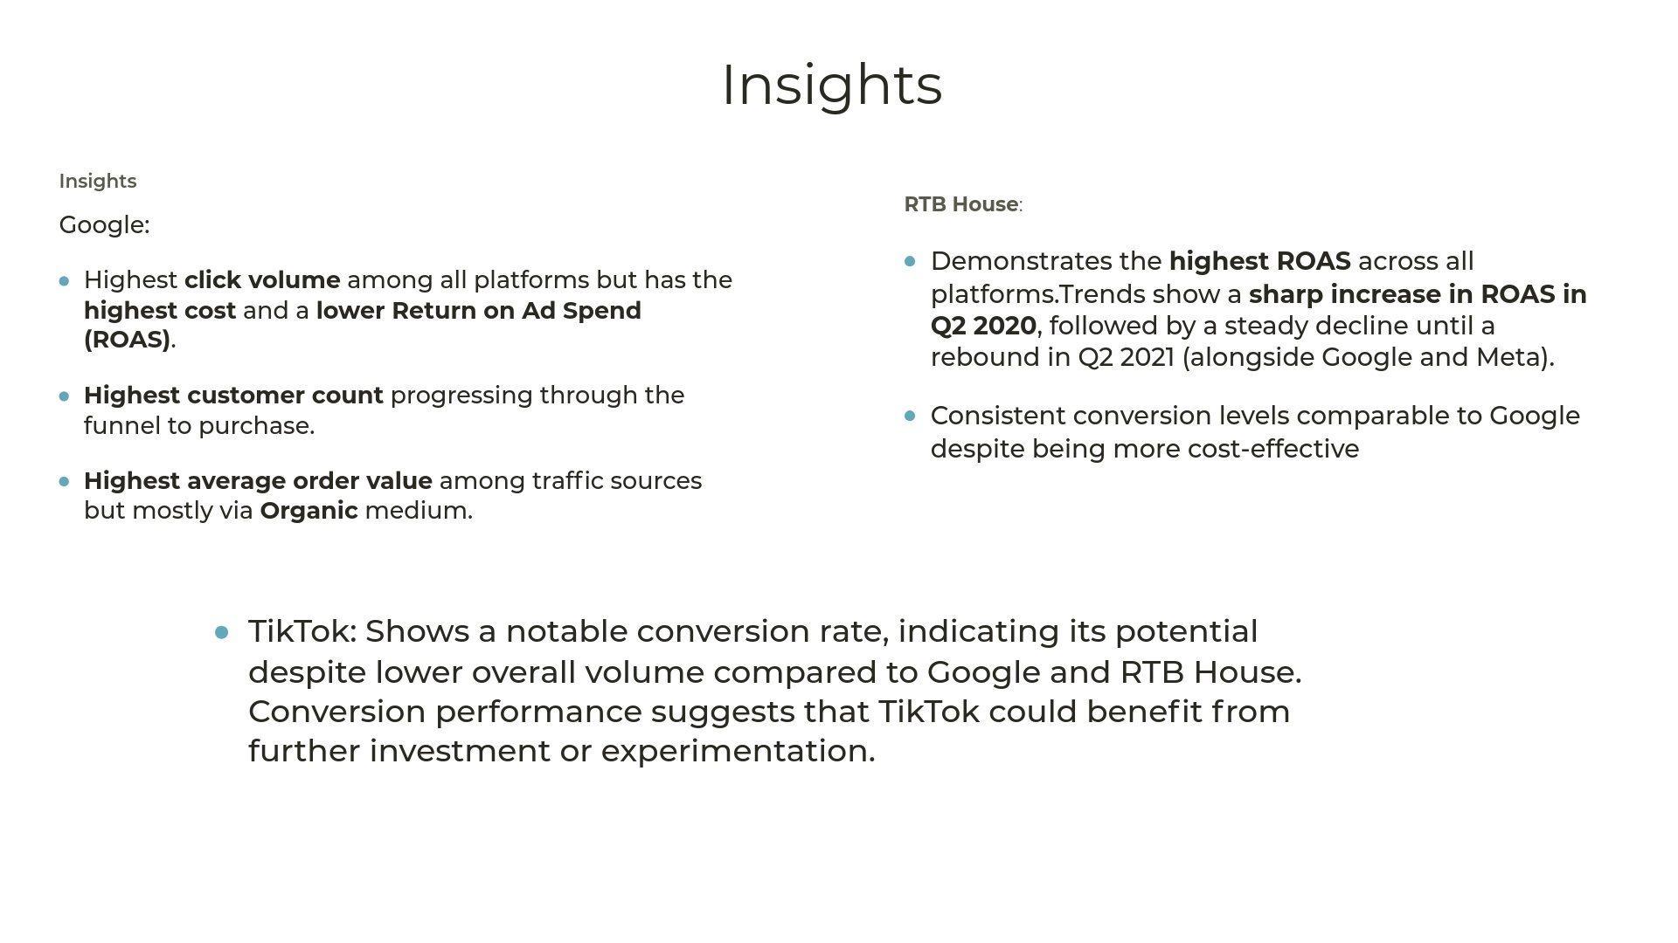
Notes:
This slide presents a comparative analysis of advertising performance between Google and TikTok. Google leads in key metrics such as click volume, customer count, and average order value, indicating its strong market presence. However, it also comes with a higher cost and a lower return on ad spend (ROAS), which raises questions about efficiency. On the other hand, TikTok, while having lower overall volume, boasts a notable conversion rate, suggesting that it could be a valuable platform for targeted investments. Additionally, RTB House stands out with the highest ROAS, although its performance has shown significant fluctuations over the past two years. This insight can guide our advertising strategy moving forward, emphasizing the need to balance cost with potential returns across different platforms.

Slide 13
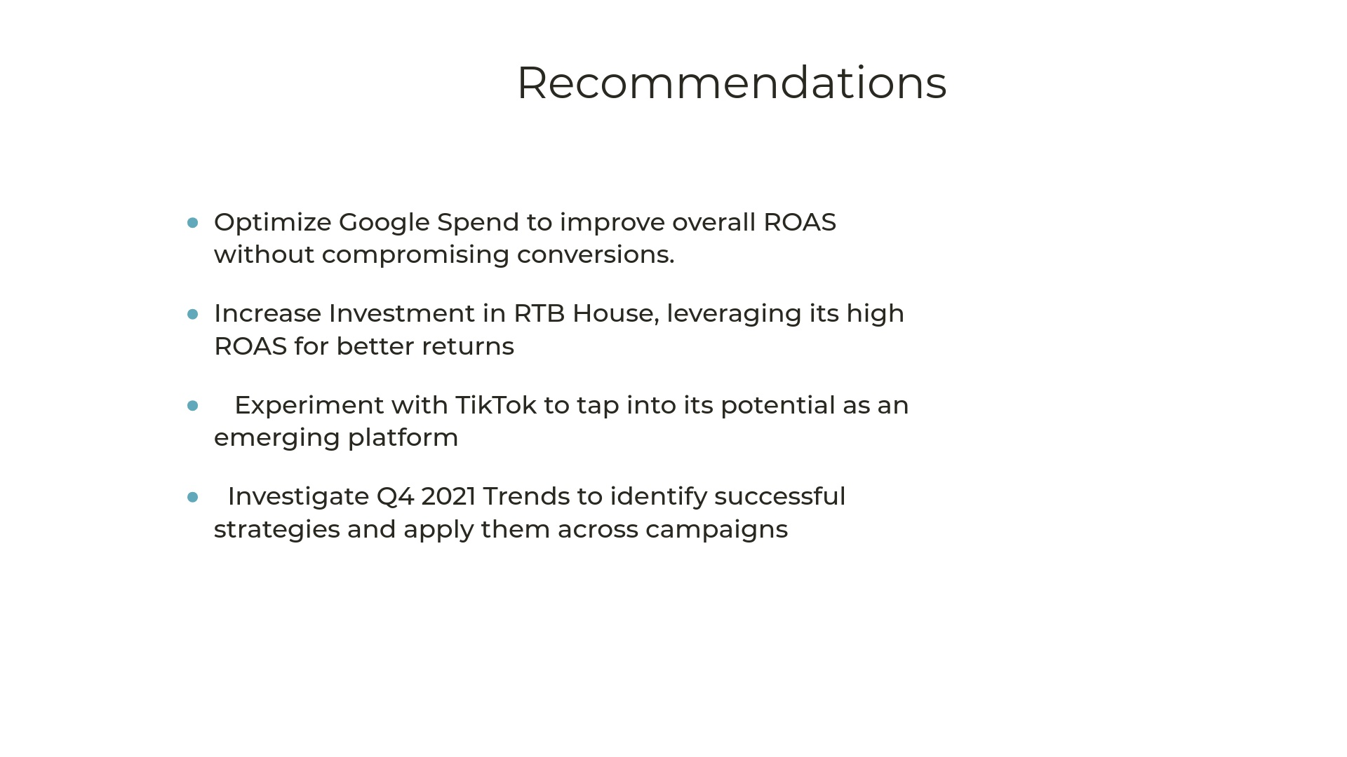
Notes:
This slide outlines four strategic recommendations aimed at enhancing our marketing effectiveness. First, optimizing Google Spend is crucial for improving our Return on Ad Spend (ROAS), ensuring that every dollar spent yields maximum returns. Next, increasing our investment in RTB House can leverage their advanced technology for better targeting and efficiency. Additionally, experimenting with TikTok presents an opportunity to tap into a younger audience and explore innovative advertising formats. Lastly, analyzing Q4 2021 trends will help us identify successful strategies that can be replicated across our campaigns, allowing us to stay ahead of the competition. Each of these points is designed to drive growth and improve our overall marketing strategy.

Slide 14
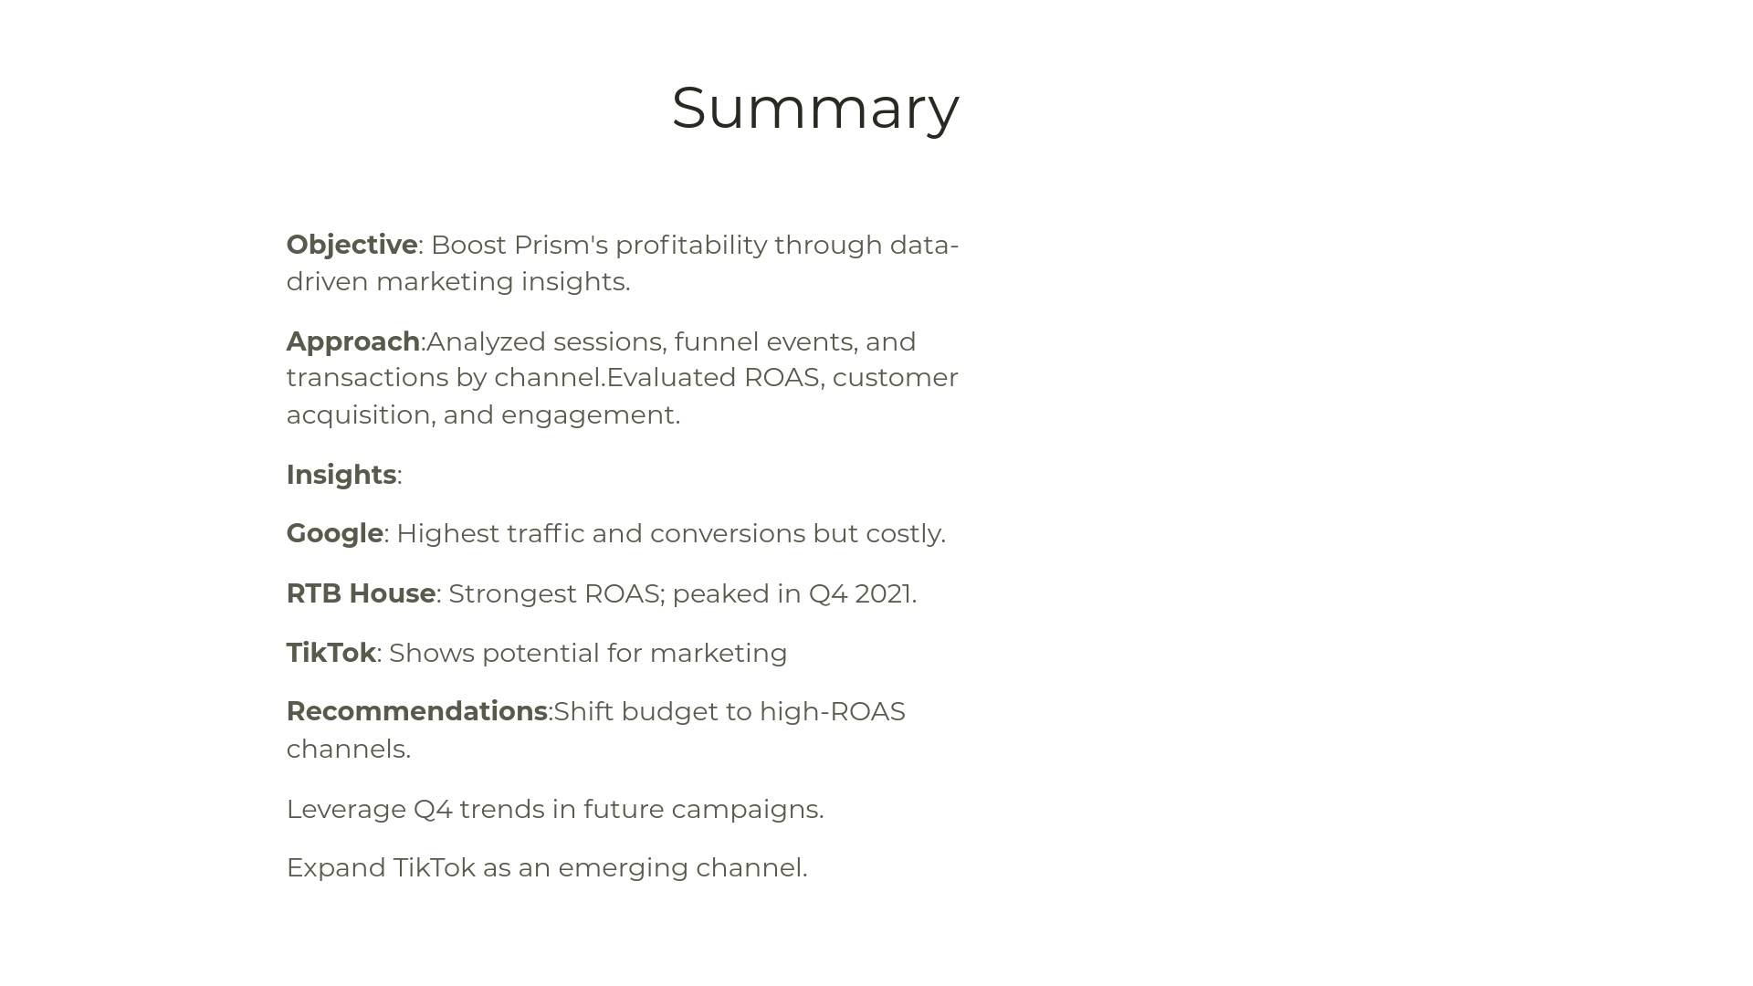

Slide 15


